Slide 1
Module 3. A human rights-based approach to aging

Slide 2
About
The human rights training toolkit has been developed for HelpAge International staff members, network members and partners to learn about the rights of older people and key elements of a human rights-based approach to ageing.
This is the third of three PowerPoint slide decks to accompany each of the three training modules. Module 3 focuses on the key principles of a human rights-based approach (HRBA) to ageing and how to adopt and promote a HRBA to ageing in practice.
Notes:
If you this module immediately follows a training session on Module 2 (including an introduction), then hide this slide.

Slide 3
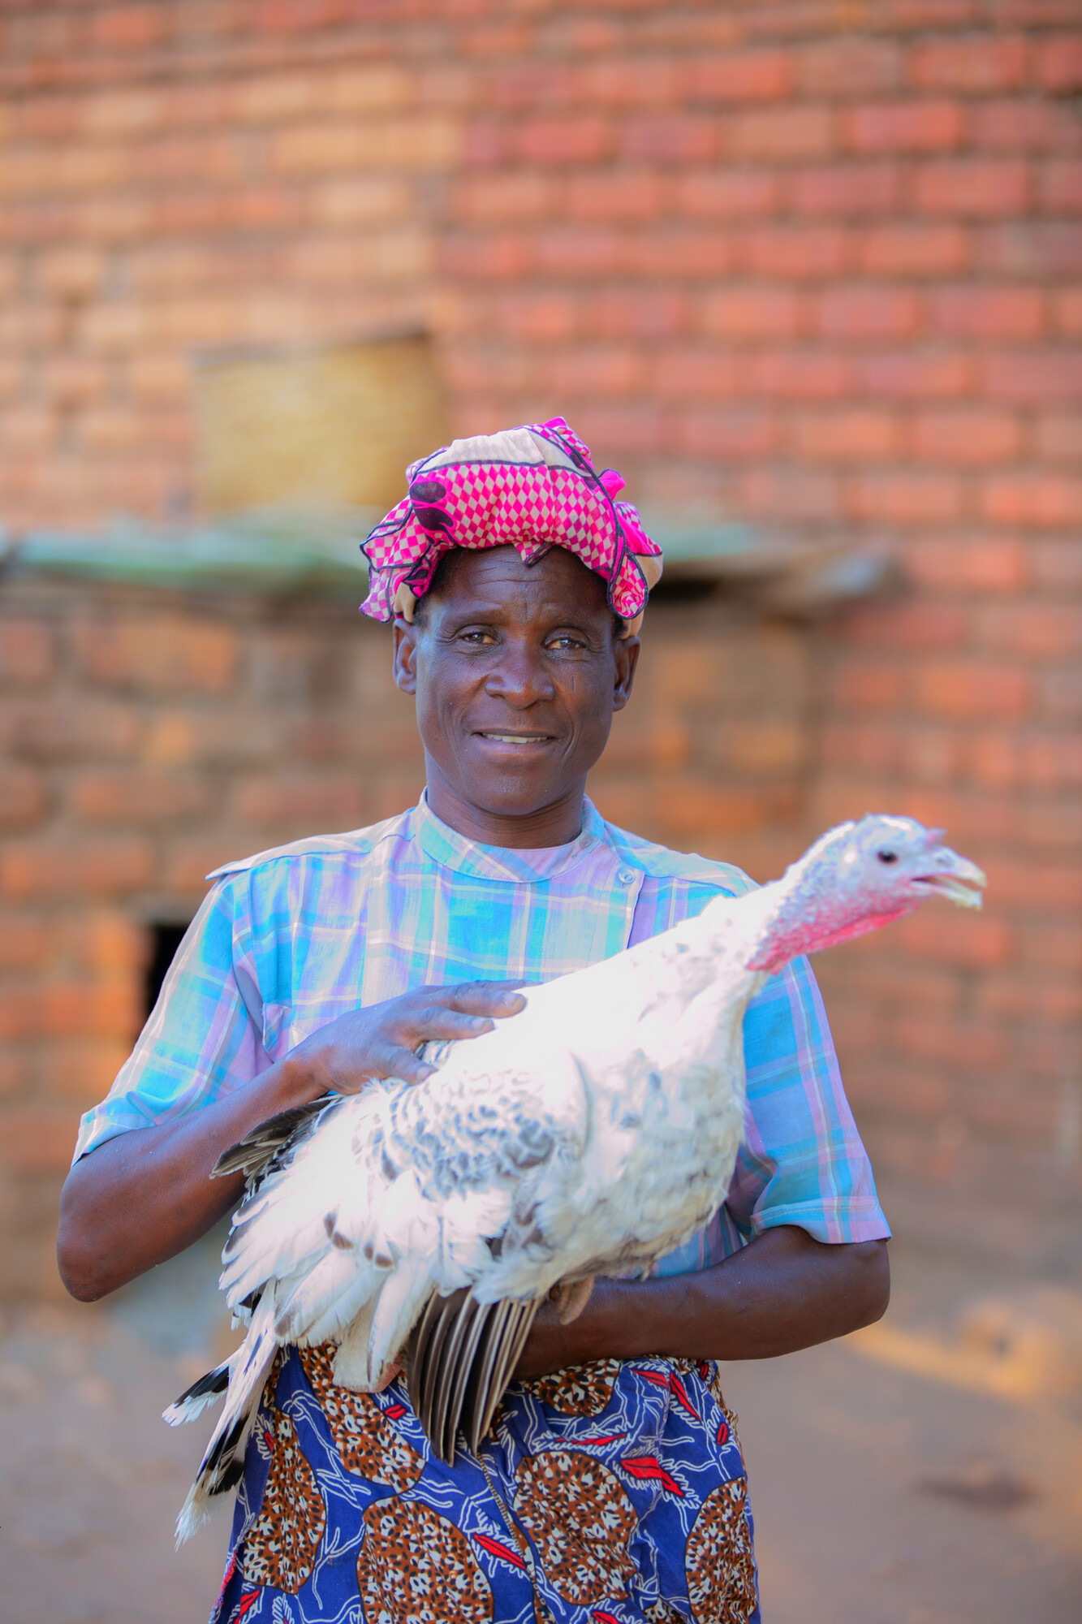
Module 3: Outline
Definition and value of a HRBA
Adopting HRBA to ageing in practice
  PANEL principles
  Language
Advocating for a HRBA to ageing
  Human rights messaging
  Engaging with Governments
  Engaging with UN human rights mechanisms

Slide 4
What is a human-rights based approach to ageing?

Slide 5
The UN definition
A common understanding
Further the realisation of human rights as laid down in international human rights instruments.
Guided by human rights standards contained in, and principles derived from international human rights instruments.
Contribute to the development of the capacities of ‘duty-bearers’ to meet their obligations and/or of ‘rights-holders’ to claim their rights.
Notes:
There are many definitions of a HRBA, but one that is well-known is the UN definition of a HRBA to Development.
In 1997, the Secretary-General called on all entities of the UN system to mainstream human rights into their various activities and programmes. Up until then, international development, human rights and international security had developed in silos.
UN agencies adopted their own approach and interpretation to a HRBA, however. So, there was a need for a more uniform approach, a “common understanding”. UN agencies defined what a HRBA would entail for all development cooperation programs and activities, in all sectors.
Definition Source: The Human Rights Based Approach to Development Cooperation: Towards a Common Understanding Among UN Agencies (2003)

Slide 6
Why we need a HRBA to ageing
Emphasis on the negative impact of demographic changes, the “burden” of an ageing society (“grey wave”, “silver tsunami”)
Prevailing narrative = if older people contribute to society, they “deserve” to be included (“Active Ageing”)
This denies older persons the rights that are inherent to all human beings
Notes:
International development policies and strategies have historically focused on the impact of demographic changes on society. There is often an emphasis on the economic consequences and how to overcome the challenges of an ageing society. This contributes to ageism and the perception of older people as a burden.
This is reflected in the terminology used, such as the grey wave or the silver tsunami.
Consequently, the prevailing narrative in development is that if we get older people to contribute to society, they “deserve” to be included. It’s about how we can ensure older people remain assets rather than burdens.
Think of the “Active Ageing” approach, which ultimately is about keeping older people healthy so they remain productive. This supports the idea that only if we are active contributors, are we also full and worthy members of society. This approach also disregards the context and environmental factors that determine the degree to which older people are included.
This approach denies older people’s rights that are inherent to them, regardless of whether they are “active”.
Governments and other duty bearers, such as private employers, have an obligation to respect, protect and fulfil older people’s rights, regardless of their age and regardless of their contributions to society.

Slide 7
HelpAge definition
Human rights principles
Human rights standards
HRBA
A rights-based approach is a way of working which is based on human rights and aims to ensure older people’s dignity, voice and wellbeing.
Notes:
For our own definition, we aimed to focus on the core characteristics of a HRBA to ageing.
Human rights standards are the norms we find in human rights treaties and other instruments. Human rights principles are overarching principles that will define how rights are applied in practice.
Essentially, it is a way of working that ensures that are older people’s human rights are at the centre of policies and practice.
Applied to policies, projects, programs, practices, …
Adopted by civil society, policy makers, service providers, …
Definition Source: Developed for HelpAge Strategy 2030

Slide 8
Value of a HRBA to ageing
The importance and value of a human rights-based approach to ageing is mainly that it allows us:
  To empower older people as rights-holders to claim and exercise their rights.
  To strengthen capacity of Governments and other duty-bearers who have the obligation to respect, protect, promote, and fulfil older people’s human rights.
It is the most appropriate and effective framework to challenge ageism.

Slide 9
Key principles of a HRBA to ageing

Slide 10
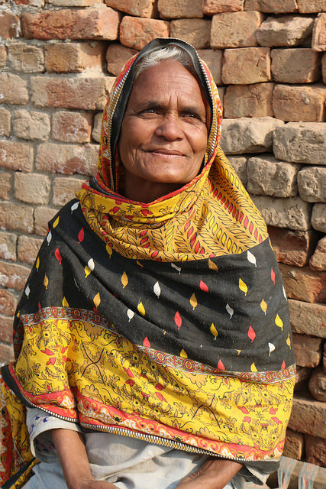
The PANEL principles
Participation
Accountability
Non-discrimination
Empowerment
Legality
Notes:
While there is not a single definition of a HRBA, there are several underlying principles. The PANEL principles are one way of breaking down what a human rights based approach means in practice. Each letter represents one of the key principles.
Sometimes these principles are combined in a definition. E.g. accountability and legality tends to be mentioned together

Slide 11
Participation
Meaningful participation in decision-making
Older people have a right to participate in decision-making processes which affect the enjoyment of their rights.
It ensures that activities are based on older people’s perspective.
Participation must be active, accessible and meaningful.
Notes:
Participation is about meaningful participation in decision-making.
Active participation of older persons is essential to ensure that policies are developed from their perspective: their lived lives, needs, priorities and ambitions, and not from the perspective of others, which may include ageist assumptions, pre-conceptions and stereotypes.
Direct participation of, and consultation with, older persons and their representative organisations should be continuous and integral to the process.
Accessibility refers, among others, to ensuring that relevant information is accessible.
Meaningful participation is also one of the key components of VOICE and the VOICE framework.

Slide 12
Accountability
Rights holders and duty bearers
Adopting a HRBA represents a fundamental shift
from older persons as objects of charity to rights holders.
from charity to the obligation of duty bearers to protect, respect and fulfil their fundamental rights.
It includes capacity-building of duty bearers.
It requires effective monitoring of human rights standards.
Notes:
Human rights obligations can also attach to private individuals, international organizations and other non-State actors. However, the State remains the primary duty-bearer under international law.
Accountability is not necessarily about confrontation with duty bearers. It also aims to enable duty-bearers to meet their obligations, through awareness raising or capacity building.
Other than States, who could be important duty bearers with regards to the rights of older people?

Slide 13
Non-Discrimination and equality
Tackling the root causes of inequality
A HRBA analyses the causes of inequality.
All forms of discrimination must be prohibited, prevented and eliminated. This includes discrimination against older people on the basis of age or any other ground, including multiple or intersectional discrimination.
To achieve equality, those most at risk must be prioritised.

Slide 14
Empowerment
Empowering rights holders to claim their rights
Older people and other rights holders should understand their rights and be able to claim and exercise their rights.
This includes supporting them in their claim, and to participate in the decisions and development of policies that affect them.
Notes:
Other potential rights holders include family members, formal and informal caregivers.
Empowerment is another key aspect of Voice.

Slide 15
Legality
Human rights create legal obligations
Legal guarantees confirm the position of older people as rights holders and of States as duty bearers.
A HRBA requires the recognition of rights as legally enforceable. It requires adhering to norms of national and international human rights law.
Notes:
The principle of legality is closely related to that of accountability.
Legal guarantees confirm the position of older people as rights holders and of States as duty bearers.

Slide 16

Group exercise: applying the PANEL principles
Notes:
If you this module immediately follows a training session on Module 1 (including an introduction), then hide this slide.

Slide 17
Applying a HRBA in our work

Slide 18
What can we do?
As thought leaders
As supporters
As convenors
Notes:
In our 2030 Strategy, HelpAge has committed to act as thought leader, supporter and convenor.

Slide 19

AS THOUGHT LEADERS
We should explore and articulate how human rights apply in older age, so that we can:
  Base our own work on this understanding of rights in older age
  Influence others to base their work on this understanding of rights
  Promote and influence the contents of a UN convention

Slide 20
Understand the right
How the right applies in older age
Ask older people
Human rights norms and standards
Notes:
To understand the right:

Slide 21
Reclaiming the narrative
Needs based
approach
Rights based
approach
Objects of our assistance
Rights holders
Passive beneficiaries
Active agents
Deserve our attention and generosity
Obligation to respect rights
Focus on vulnerability of the
Focus on environmental and societal
individual/community
barriers to the equal enjoyment of rights
Addresses symptoms of ageism
Addresses causes of ageism
Doesn’t address power imbalances
Addresses power imbalances
Accountability of NGO to donor
Accountability of State and service
providers (incl. NGOs) to older people
Notes:
As thought leaders, we should help reclaim the narrative.

Slide 22
Language matters
Language to avoid
Language to use
The Elderly
Older people or older persons
Vulnerable or a vulnerable group
At risk of.. Excluded by.. Marginalised
by..
Them
Us: When we are older.. In our older
age..
As long as possible
… so we can live in our own
home
. Full
stop.
Deserve rights, attention, investment
We have the right to.. Authorities have
an obligation to..
Untapped resources, assets
People, rights holders
Notes:
As thought leaders, we should also think about the language we use.

Slide 23
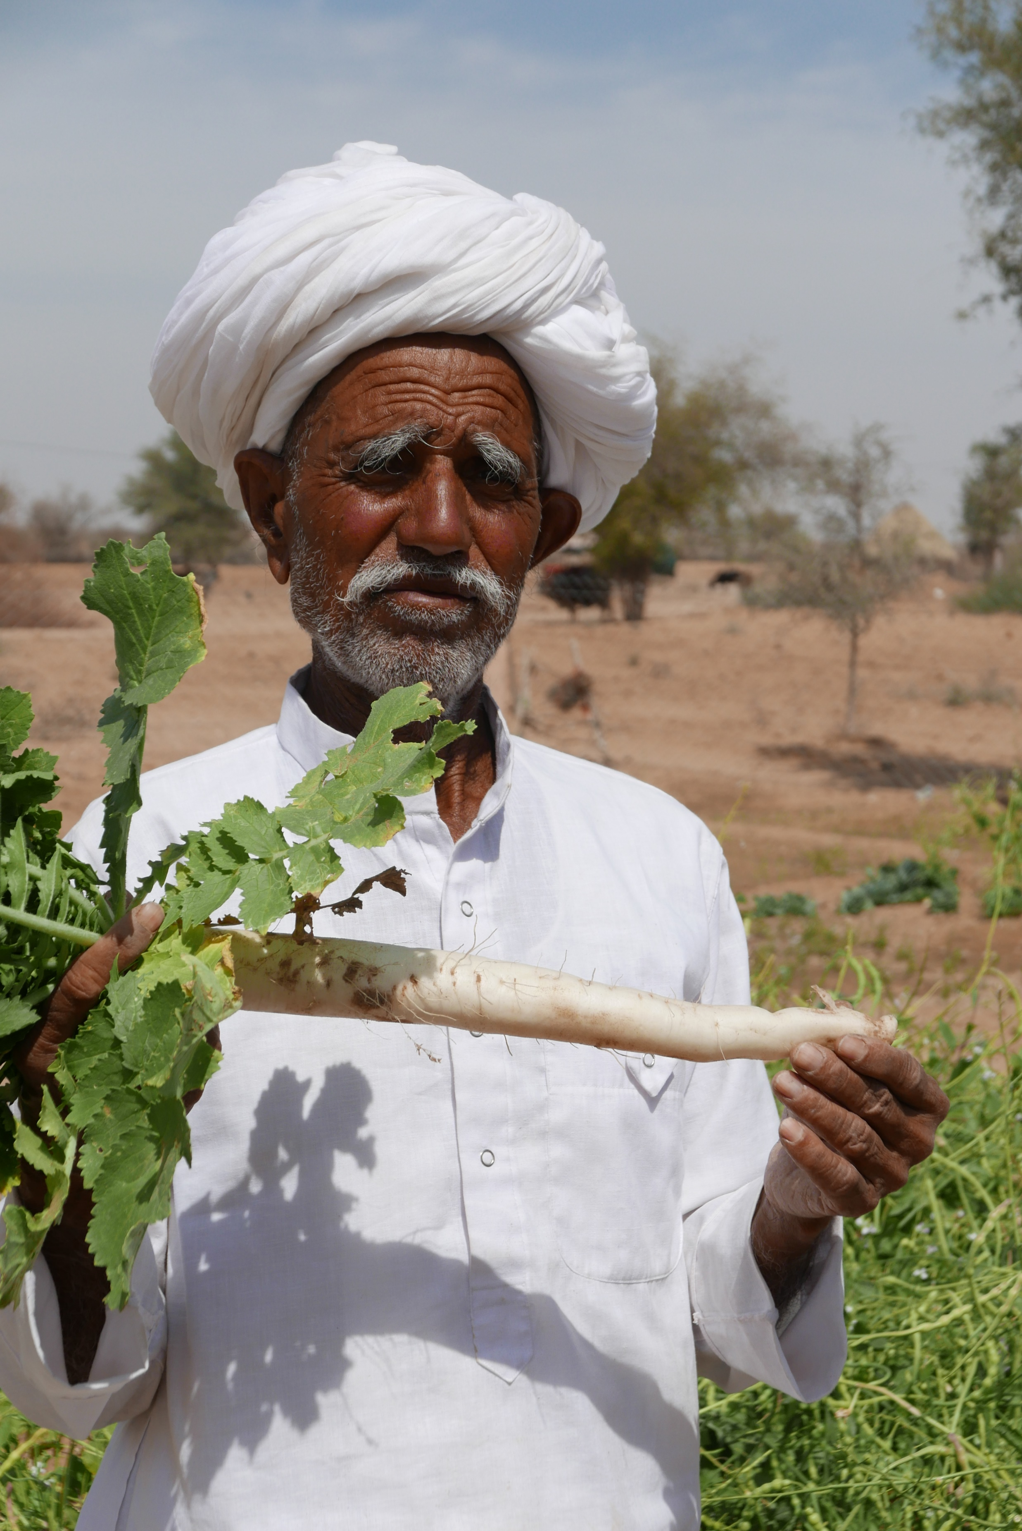
AS SUPPORTERS
We should support older people as rights holders:
To participate in all aspects of life, and in decision-making processes that affect their lives and those of others
To know their rights and be able to demand their protection
To hold public authorities accountable when their rights are denied
To use their voice and be self-advocates for their rights

Slide 24
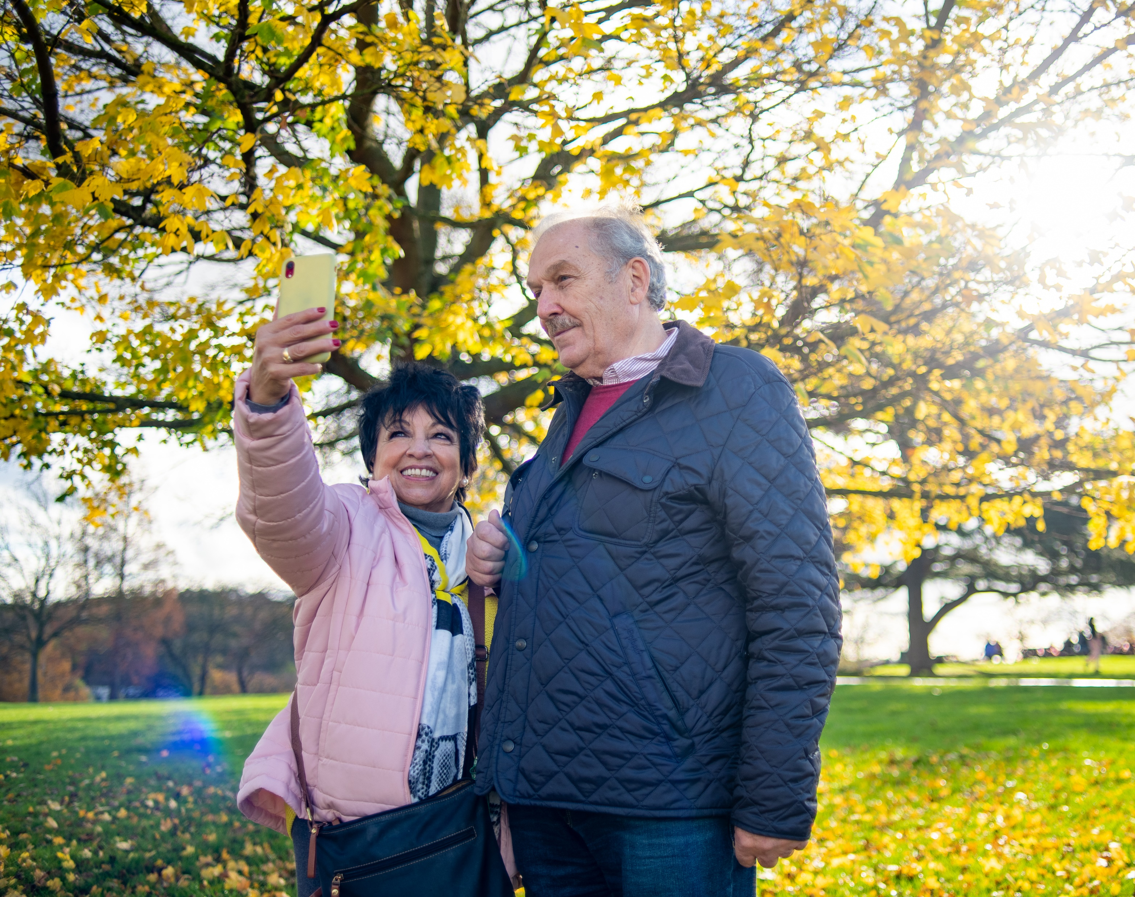
AS SUPPORTERS
We should support public authorities, including service providers, as duty bearers:
To understand their human rights obligations towards us when we are older
To develop laws and policies which promote and protect our rights in older age
To design, deliver and monitor services which promote and protect our rights in older age

Slide 25
AS CONVENORS
We should ask ourselves about what, how and who we convene:
Are those whose rights are affected included?
How are they included?
Whose voice are we privileging?
Where are we convening?
Is it accessible?
Do we need rights-based guidelines to support us to convene better?

Slide 26

It’s quiz time!

Slide 27
Advocating for rights and a HRBA to ageing

Slide 28
Advocating for rights
Integrating human rights in ALL our messaging
Engaging with Governments
Engaging with UN human rights mechanisms:
  Promoting drafting of new instruments or ratification of existing instruments
  Submitting written information and parallel reports
  Encouraging Governments to engage
  Using reports and recommendations for advocacy at national level

Slide 29
Group exercise: human rights messaging
Notes:
If you this module immediately follows a training session on Module 1 (including an introduction), then hide this slide.

Slide 30
Group exercise: responding to human rights critiques
Notes:
If you this module immediately follows a training session on Module 1 (including an introduction), then hide this slide.

Slide 31
Tools & resources

Slide 32
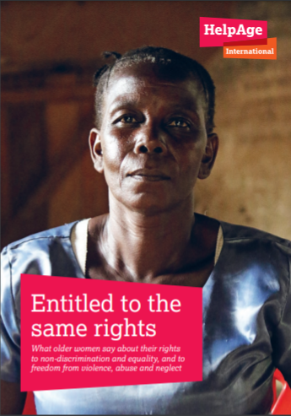
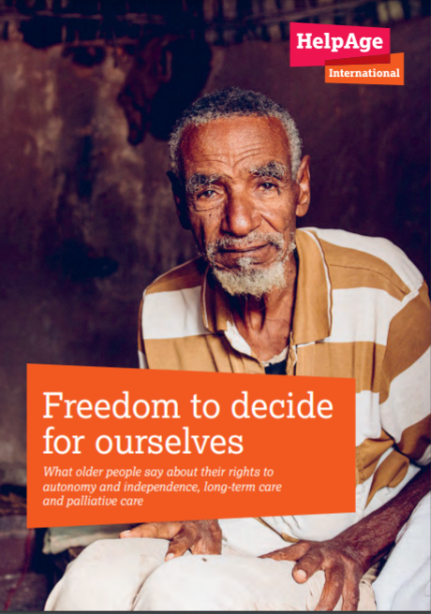
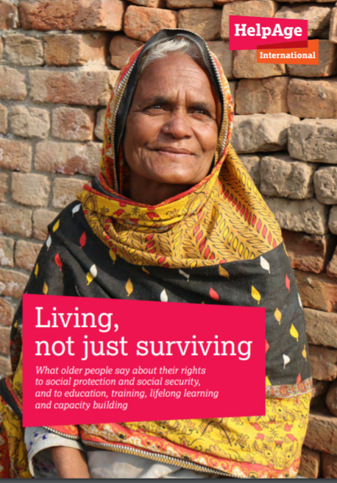
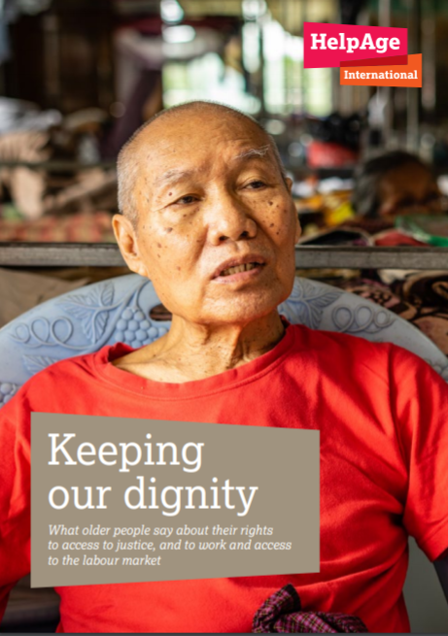
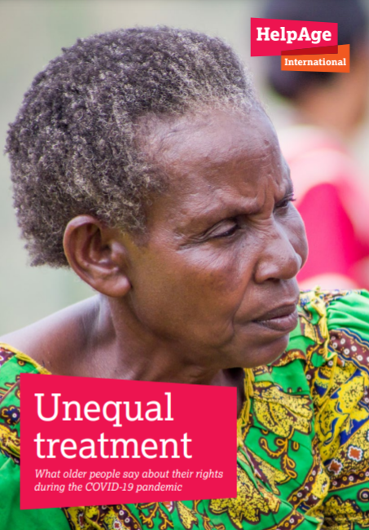
What older people say series
Notes:
New report for 2023: health and social inclusion.
All the reports can be downloaded here: https://www.helpage.org/what-we-do/rights-of-older-people/un-convention-on-the-rights-of-older-people/

Slide 33
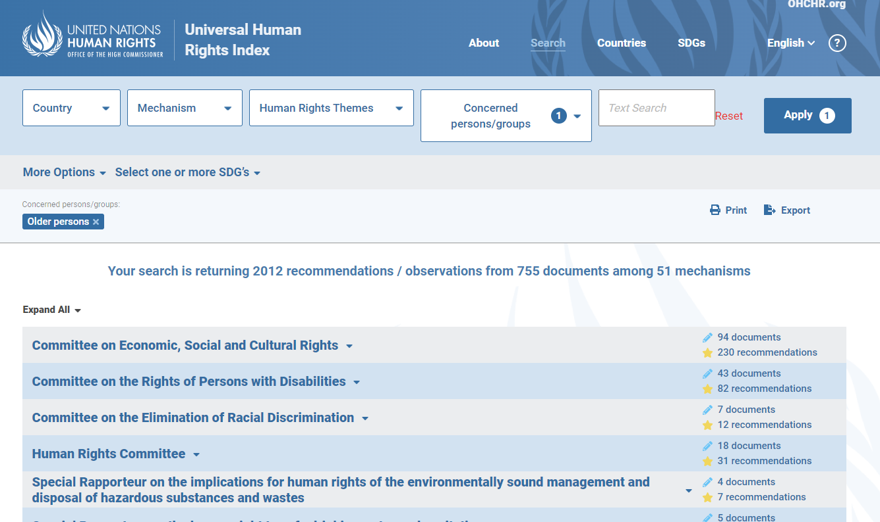
UN human rights index

Slide 34

OHCHR civil society resources
Notes:
https://www.ohchr.org/en/resources/civil-society

Slide 35
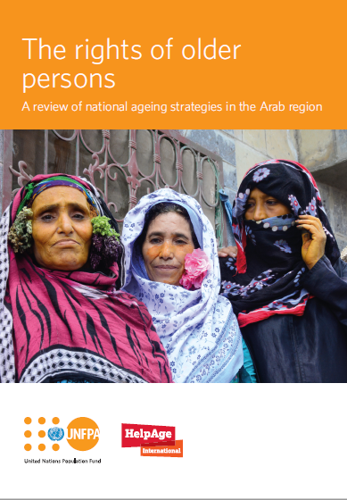
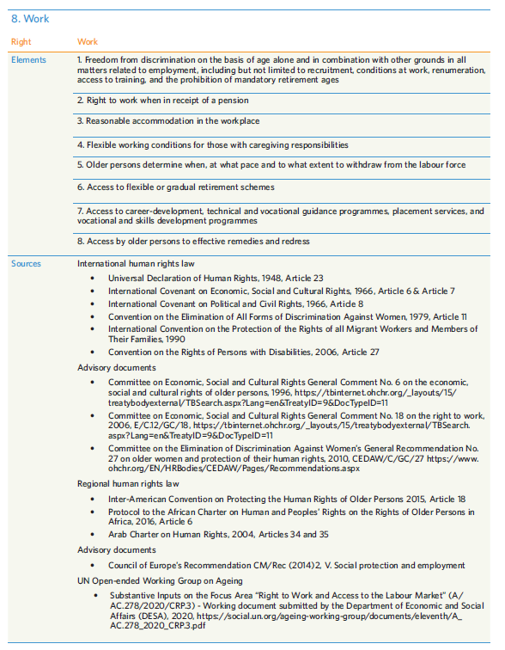
Tools: A HRBA to ageing policies
Notes:
In 2020, HelpAge and UNFPA published a review of national ageing strategies in six Arab countries: Egypt, Jordan, Saudi Arabia, Syria, Tunisia, and the United Arab Emirates. It assesses the extent to which the policies are in line with human rights principles and standards.
A set of core elements, or indicators, was developed for each right. The action plans or activities of the national strategies were then reviewed against these to assess the extent to which they address the rights concerned and are in line with human rights standards.
The overview of rights and the different indicators that were developed can be used to review and assess other national policies and strategies.
The review shows that there are significant gaps in the strategies. While they address some elements of the rights covered, they do not address all of them. For example, access to palliative care is not included under health and social care. There are no measures to ensure older persons can exercise their autonomy over their care and support services in line with their will and preferences. Another significant gap is the lack of measures to ensure older persons’ access to effective remedies and redress when these rights are denied

Slide 36
Tools: A HRBA to ageing policies
Notes:
To further encourage and support Arab States to better align their national ageing strategies and policies with a comprehensive human rights approach, HelpAge and UNFPA produced a Guide entitled ‘The Right to Dignified Ageing – A Guide to Establishing Rights Based Policies for Older Persons in the Arab Region.
Using practical examples and a wide range of case studies it provides a practical tool for policy makers to formulate new, and revise existing, strategies on ageing, to better align them with human rights standards.

Slide 37
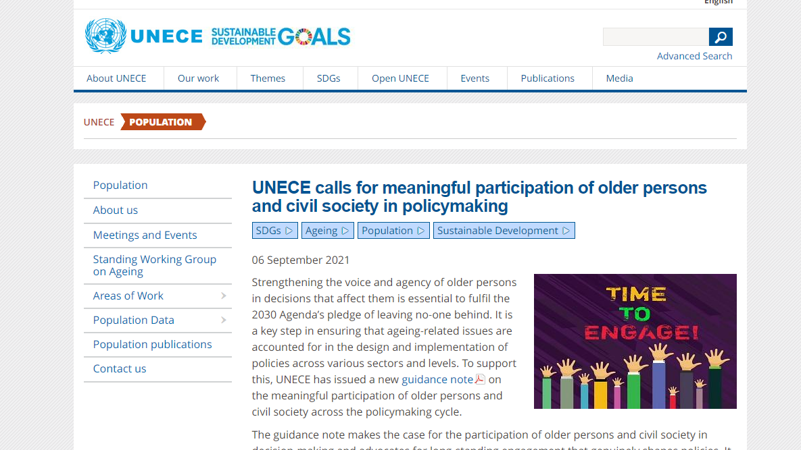
UNECE guidance note on meaningful participation of older persons and civil society
Notes:
https://unece.org/population/news/unece-calls-meaningful-participation-older-persons-and-civil-society-policymaking

Slide 38
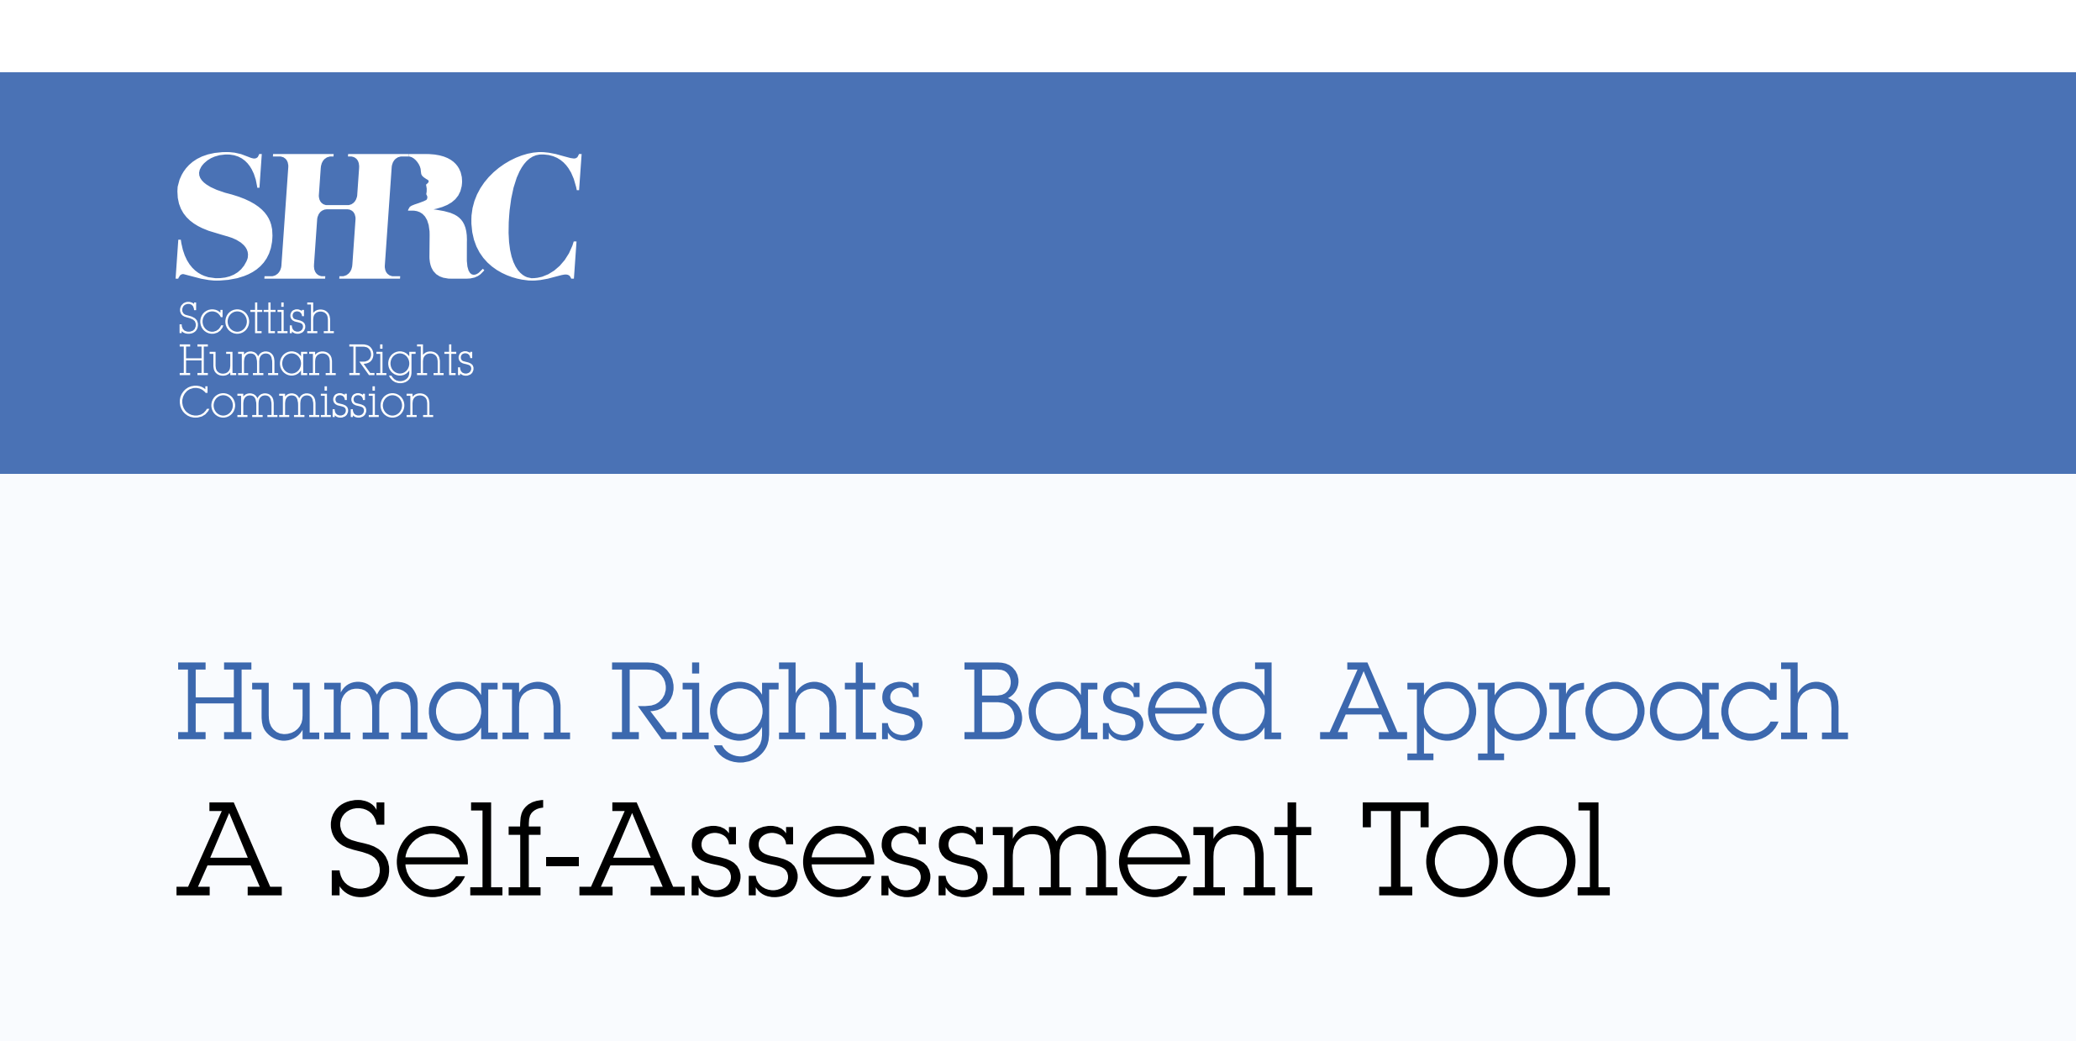
Self-assessment tool
https://www.scottishhumanrights.com/
Notes:
The Scottish Human Rights Commission developed a self-assessment tool, based on the PANEL principles.

Slide 39
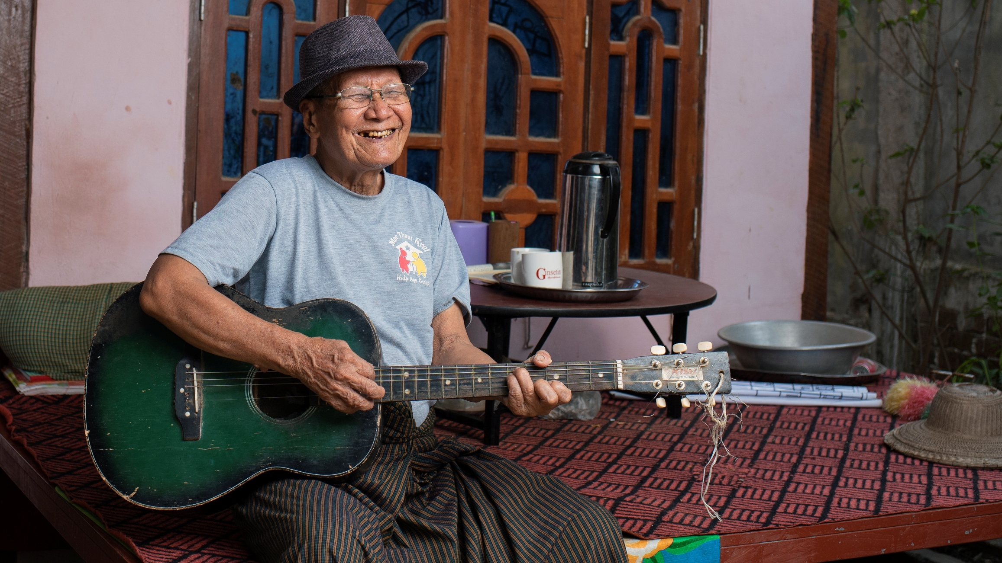



Thank you!
www.helpage.org
HelpAgeInternational
@HelpAge

